Slide 1
Species invasions!
GK-12 Fellows Liz Schultheis & Melissa Kjelvik

Slide 2
What is an invasive species?
Introduced from another country by people
Grows and takes over an area
Can harm native species
Cost people a lot of time and money

Slide 3
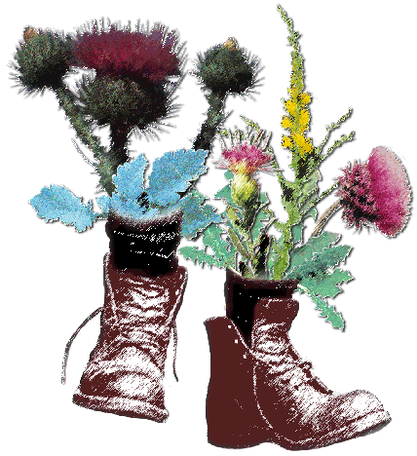
Do you know of any invasive species?

Slide 4
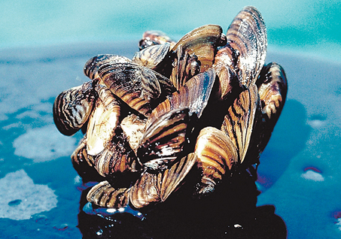
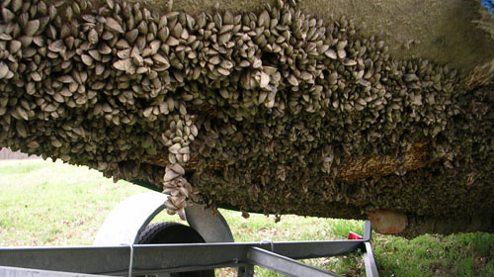
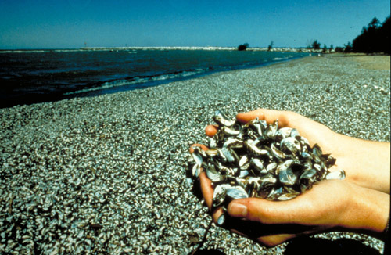
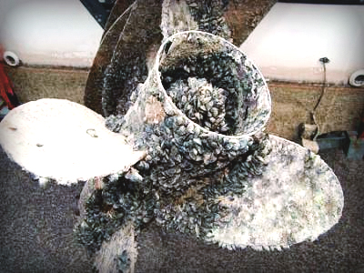
Zebra Mussel
Notes:
Females can produce up to one million eggs per year. From Russia, introduced in ballast water.
There are a few fish in NA that eat ZM, but none that control its population numbers
Filter feeders, clear the water and out compete native mussel species

Slide 5
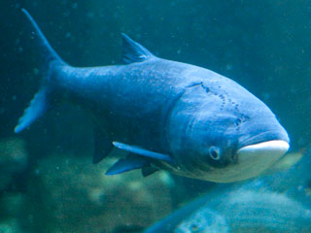
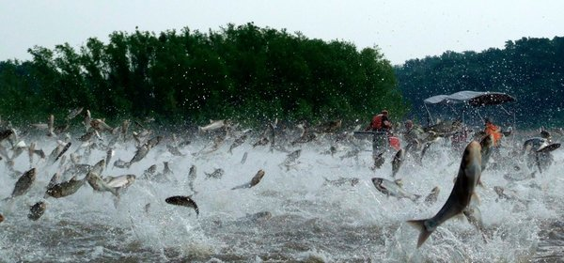
Asian carp
“To combat these and other invasive species, which could threaten the Great Lakes ecosystem and its $7 billion fishing industries, the resources defense council has proposed physical barriers to separate Chicago waterways and Lake Michigan from the Mississippi.”
- NY Times November 2011
Notes:
Picture: Silver Asian carp jumping out of the Illinois River in 2009. Nerissa Michaels/Illinois River Biological Station, via Detroit Free Press.
Two Asian carp species, silver and bighead carp, imported from China in the 1970s, escaped from their pens at fish farms in Arkansas and Kentucky. Disrupting ecosystems thanks to their voracious appetite for plankton and algae that other species need to survive, the carp swam up the Mississippi River, crowded the Illinois River and other regional waterways, and zeroed in on Chicago and the Great Lakes.
http://www.nytimes.com/2011/11/11/us/with-fears-of-asian-carp-fading-a-sleek-campaign-to-revive-public-concern.html

Slide 6
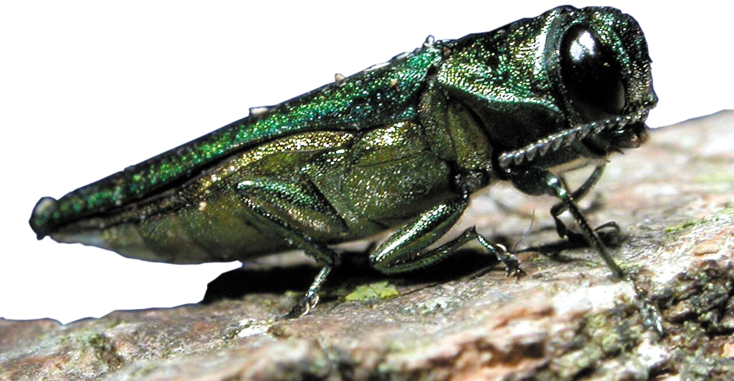
Emerald Ash Borer
Notes:
Has killed 100 million ash trees and threatens billions more. From Asia.

Slide 7
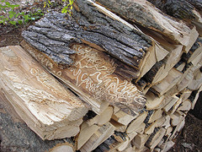
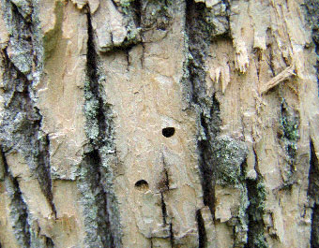
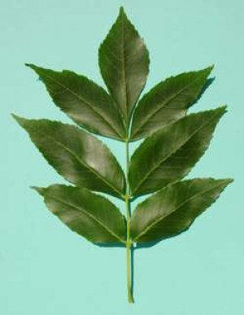
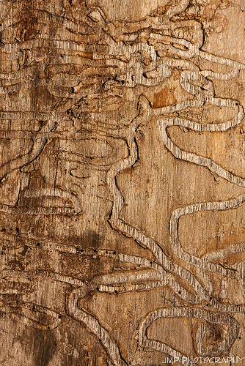
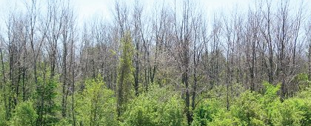
Emerald Ash Borer
Notes:
Make baseball bats out of ash.

Slide 8
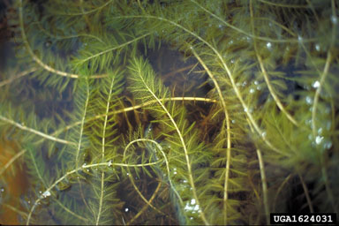
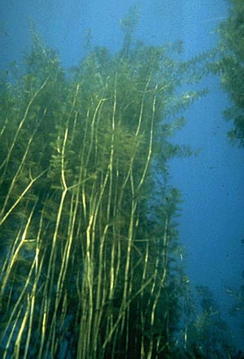
Milfoil
Notes:
From Europe and Asia.

Slide 9
What makes a good invader?
Easily moved to new locations by humans
Ability to reproduce quickly and spread far
Nothing eats them! No natural enemies
Take habitat away from native species

Slide 10
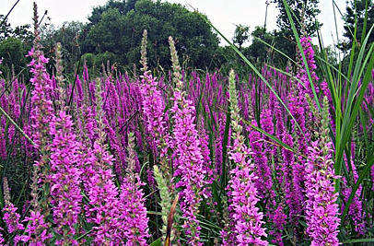
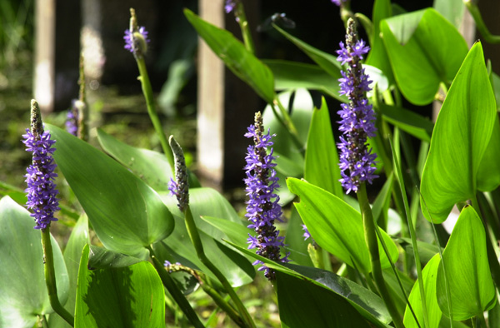
Invasive
Native
KBS GK-12 Project
Purple loosestrife
Pickerel-weed

Slide 11
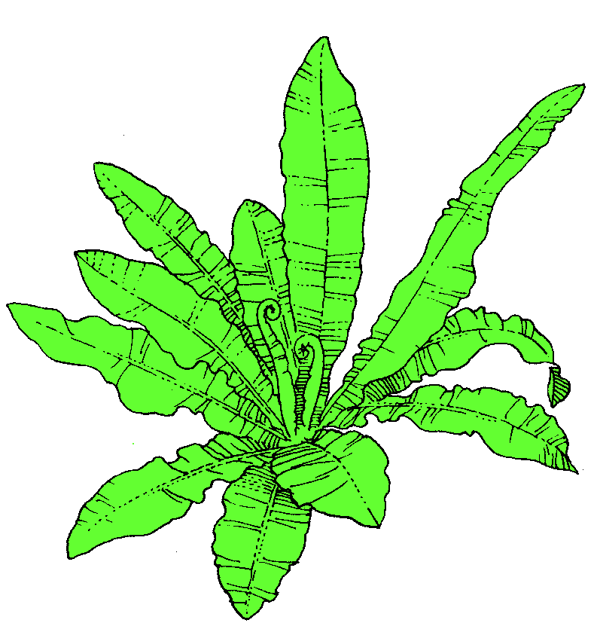
Purple Loosestrife
Pickerelweed
Move forward:
Growth:
Seeds:
Disperse:
Move backward:
Herbivory:
Disease:
Fire:
Drought:
Human disturbance:
Move forward:
Growth:
Seeds:
Disperse:
Move backward:
Herbivory:
Disease:
Fire:
Drought:
Human disturbance:
KBS GK-12 Project

Slide 12
Purple Loosestrife
Move forward:
Growth:
Seeds:
Disperse:
Move backward:
Herbivory:
Disease:
Fire:
Drought:
Human disturbance:
KBS GK-12 Project
All species can grow, produce seeds, and disperse
Abilities differ between species

Slide 13
Purple Loosestrife
Move forward:
Growth:
Seeds:
Disperse:
Move backward:
Herbivory:
Disease:
Fire:
Drought:
Human disturbance:
KBS GK-12 Project
Some actions harm native species more than invasive species
These actions facilitate invasion

Slide 14
Purple Loosestrife
Move forward:
Growth:
Seeds:
Disperse:
Move backward:
Herbivory:
Disease:
Fire:
Drought:
Human disturbance:
KBS GK-12 Project
Some actions harm invasive species more than native species
These actions resist invasion

Slide 15
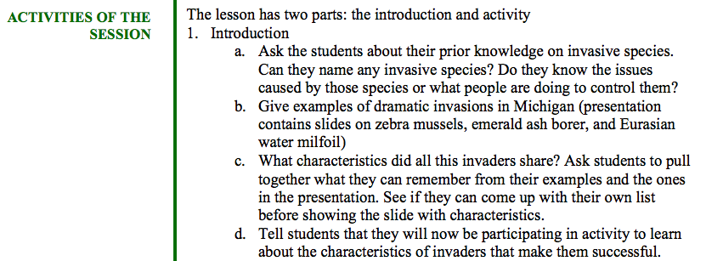
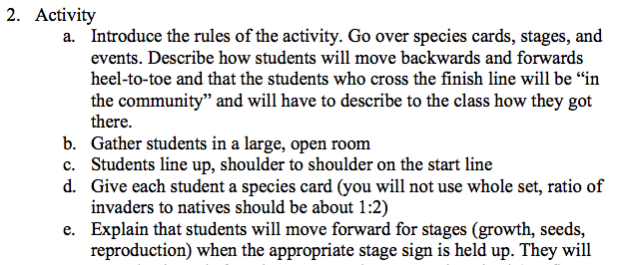
KBS GK-12 Project
Notes:
Here is a lesson plan that is available on the web

Slide 16
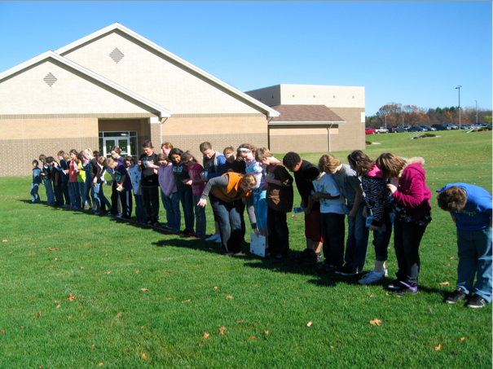

Slide 17
